Slide 1
410
410
400
400
What is the total upwards force on this pipe?
Notes:
Have them try to figure it out

Slide 2
Wrapping Up

Slide 3
Breakout Rooms!
Physics
Vectors, moments & more complicated equations
CAD
Wrap up your plane and explore more of Onshape

Slide 4
CAD

Slide 5
CAD Resources
Introduction to Onshape: https://docs.google.com/presentation/d/1xeUxZzebttCaFUHAa8jpXeTGzo0Tw75Fvbtii2Q1DHs/edit?usp=sharing
Fuselage CAD: https://docs.google.com/presentation/d/1m8bZDU3KNS0YIf5zZQfhWM6XXz4VBbRGKAJzTL50izQ/edit?usp=sharing
Wing CAD: https://docs.google.com/presentation/d/1Zwwbx3YF4BBvrvxOHhczT1IoESDwH61YPEcg7NDjvBg/edit?usp=sharing
Tail CAD: https://docs.google.com/presentation/d/1_pm-QMSjJxjgBE40J0ZzKYYfk2SDVXfrekTx_jnymms/edit?usp=sharing

Slide 6
Physics

Slide 7
Advanced Equations
For people who want/if we have extra time

Slide 8
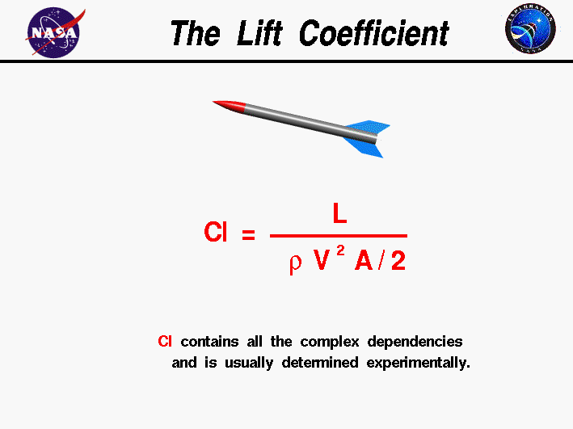
Lift Coefficient Equation
Notes:
L = Newtons (how much lift the plane can produce) 1 Newtons = 4.4482 lb
P = Kg/m (density of the air)
V = Velocity of the plane (meters per second)
A = area^2 m
From imperial units to Cl:
Lift coefficient unit:

Slide 9
Solve for the Lift Coefficient:
Velocity = 46 knots
Lift = 503 lb
Density of Air = .0659 lb/ft^3
Chord: 6ft
Wing length: 32 ft
Cl = ?
Conversion factors:
ft^2/10.7639 = Area m^2/s
lb/ft^3/1.944 = m^2/s
Notes:
Things needed to be converted:
(6 * 32)/10.7639 = Area m^2/s
46/1.944 = Velocity m^2/s
0.0659 * 16.018 = kg/m Density
503 * 4.448 = Newtons (Lift)
Knotts

Slide 10
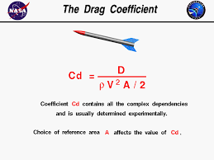
Drag Coefficient Equation

Slide 11
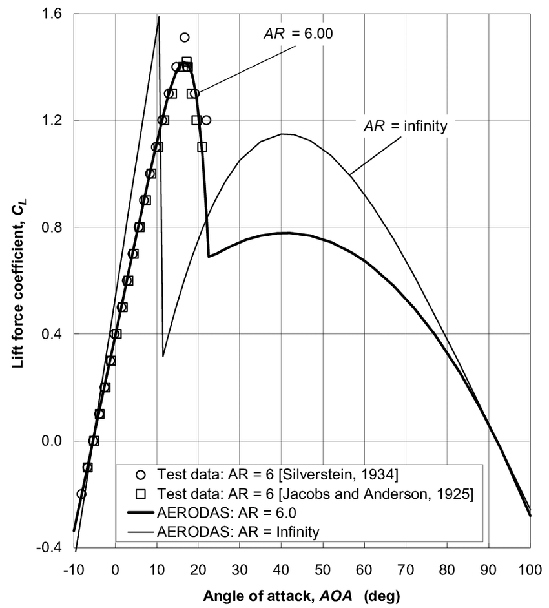
Clark-Y Airfoil Graph

Slide 12
Clark Y Airfoil Explained
AR: aspect ratio

Slide 13
V
Forces are represented by vectors
Vectors have both a magnitude (a number, the “size” of the vector), and a direction
Scalars are just numbers (1, pi, 4/3, etc.)
Ex. velocity (vector) vs speed (scalar)

Slide 14
V
|v| = 5
x component
4
y component
3
Vectors can be broken down into components (using trigonometry)
Notes:
Explain how the components create a right triangle and add up to the original vector

Slide 15
u
|u| = ?
w
|w| = 5
v
|v| = 12
Vectors can also be added or subtracted
Notes:
Work out the question using pythagorean theorem

Slide 16
u
|u| = ?
v
|v| = 7
w
|w| = 24
Try this: find u!
Notes:
Have them try to figure it out

Slide 17
Plane ground speed
Plane
70 mph
Wind
24 mph
What is the plane’s ground speed?

Slide 18
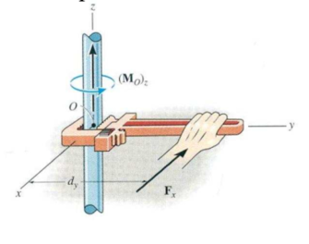
Moment is a force’s tendency to cause something to rotate
Moment = force * distance
At a large distance, small forces will have a big moment — they will cause things to rotate more than the same force at a closer distance
If you move your hand closer to the center it will be harder to spin the rod because there will be less moment

Slide 19
What is the moment here?
10 ft beam
50 lbs
Calculating moment example
Notes:
Work through Ex

Slide 20
What is the moment here?
20 ft beam
10 lbs
Now you try!

Slide 21
25 lbs
10 in
Pivot point
5 in
? lbs
What is the moment at the pivot point? What is the force at the end of the lever?

Slide 22
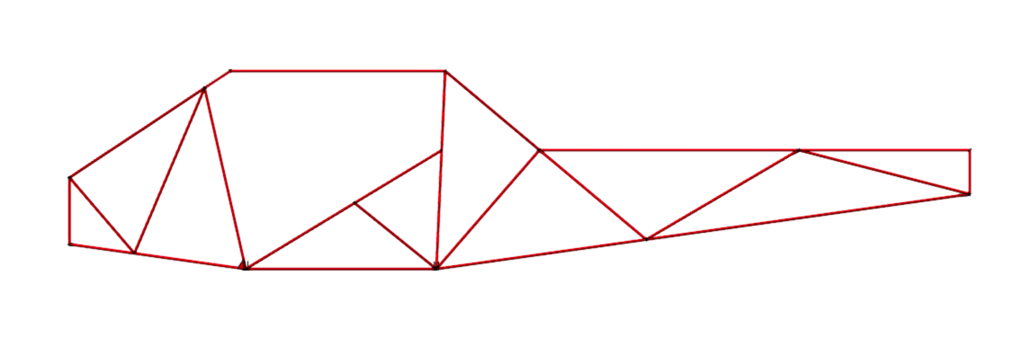
600 lbs
1 ft
15 ft
x lbs
What must x be for the moments to cancel (be equal but in opposite directions)?

Slide 23
Activity!
Make this plane: https://www.foldnfly.com/1.html
Record flight properties
Make this one: https://www.foldnfly.com/13.html#The-UFO
Record observations - differences? Similarities?

Slide 24
What did you observe?
Which flew longer?
Best glide ratio?
(glide ratio - how far you go forward vs down)
Which flew farther?
Plane 1:
Plane 2:
Notes:
Note to presenters: be ready to explain their observations →
Farthest
Slowest
Best glide ratio

